Slide 1
Hyland Hackathon
2 0 2 3
Mentor Prep Meeting

Slide 2
Thank you!
We truly could not do this without you 🥺

Slide 3
👋
Introductions
Tell us your name, role, location, and previous experience!

Slide 4
Agenda
The Basics
Student Context
Expectations
In-Person
Essential information about where to go and how things work
Things the student should know
How to be the best mentor you can be
Information for
in-person mentors

Slide 5
The Basics
Essential information about where to go and how things work

Slide 6
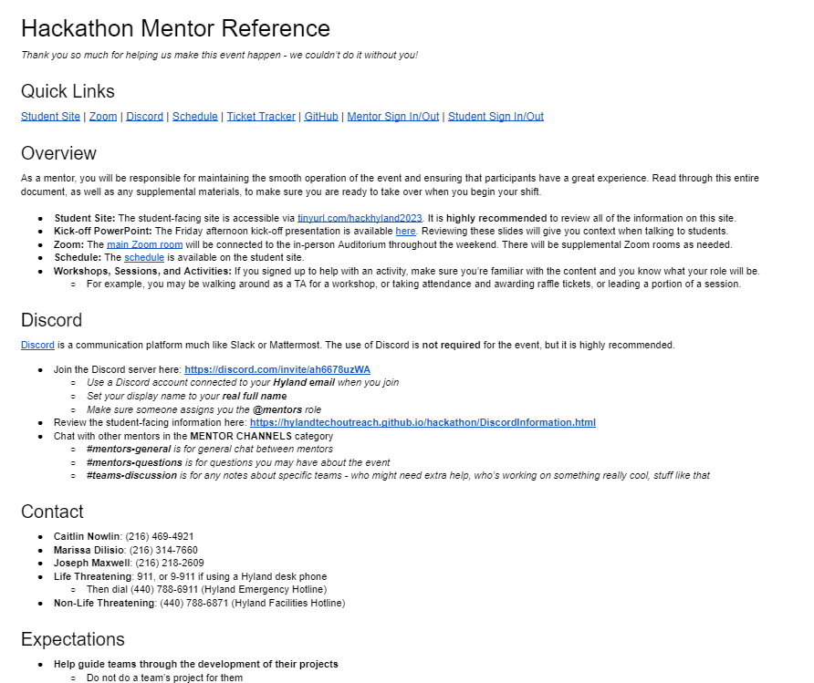
Mentor Reference Document
https://docs.google.com/document/d/1M31b103uPJ0QPDhUd_yfEFY_nJCXtzjENKnbk2AYvnA/edit
PLEASE read through this document before your shift begins 🥰

Slide 7



Places
Mentor Reference Document: Your one-stop-shop for all Hackathon information!
Teams: We will use this to communicate leading up to the event (sorry Slack people ☹)
Discord: We will use this to communicate during the event
Student Site: This is the main source of information for the students
Zoom: All activities will be broadcast via Zoom (all but one in the Main Zoom Room)

Slide 8
Schedule
https://hylandtechoutreach.github.io/hackathon/Schedule.html
Important Times
Friday, 4pm ET: Event Kickoff
Friday, 5pm ET: Team Submissions Due
Saturday, 9am ET: Day 2 Kickoff
Sunday, 1pm ET: Entry Round Submissions Due*
Sunday, 4pm ET: Final Round Begins*
Sunday, 6pm ET: Closing Ceremony*
*Subject to change

Slide 9
Workshops & Sessions
Schedule and student materials available at tinyurl.com/hackhyland2023
Lesson plans available on GitHub
Be aware of when these are happening, and encourage students to attend when applicable
If you’re helping with one of these, make sure you know the material and know your responsibilities!

Slide 10
Student Context
Things the student should know

Slide 11
Student Site
https://tinyurl.com/
hackhyland2023

Slide 12
New This Year: Tracks!
Explorer
Artisan
Scientist
🚀
🖌
🧪
For students who are just beginning their voyage into the world of software development
For students with some programming experience who are interested in the creative aspects of development
For students who love the technical details of projects and have significant programming experience
Students will select tracks when they submit their team roster on the first night

Slide 13
Competiton Rules
Fresh Code
Ownership
Teams can have up to 5 students
Only work created during the Hackathon is allowed to be included in projects
Teams have full ownership of projects created during the Hackathon

Slide 14
Judging Process
Entry Round
Mentors should help teams prepare their entry round submissions
Resources available to help students record presentations
Videos (2-3min) due by 1pm ET on Sunday
Volunteer judges will fill out rubrics and calculate total scores
Top 4 teams from each grade level will advance
More volunteers are needed to watch videos from 1:30-3:30pm!
Final Round
Top 8 teams present live (<5 mins) in front of judges, 4-6pm ET Sunday
Judges will ask questions
Judges pick the first and second place team from each grade level, and every member of those teams will win a prize!
Criteria
Innovation
UX
Quality
Impact

Slide 15
Prizes*
First Place
Razor Electric Scooter OR Bose Noise-Canceling Earbuds
Second Place
Pixel Art Bluetooth Speaker OR LED Jellyfish Lamp
Physical Raffle Prizes
Candy, Rubber Ducks, Stuffed Animal, Water Bottle, Grab Bag
Digital Raffle Prizes
Audible Credit, A.I. Portraits, A.I. Poetry, Custom Synth Track, Udemy Course
*prizes may vary
More Raffle Info Coming Up 🎫

Slide 16
Expectations
How to be the best mentor you can be

Slide 17

What To Do
More details are listed in the Mentor Reference Document
Guide Teams
Lead them to discover their own solutions – point to online resources
Keep the judging criteria in mind
Be Present
Monitor the Discord for questions or misbehaving
If no one’s asking for help – reach out!
Chat with other mentors, and let Caitlin, Marissa, or Joseph know if anything’s up
In-Person: Be Responsible
Supervise students, hand out snacks, enforce rules
Sign in/out on the digital Mentor sheet when you arrive/depart
Be available for students to sign in/out

Slide 18

Discord
More information available in the Mentor Reference Document
Discord is a communication platform like Slack or Mattermost
The use of Discord is not required
Discord is highly recommended, especially for virtual mentors
Given the @mentors role, you can access secret channels, and be notified when someone needs help
Prep Channels
For use before the event – feel free to peruse and help facilitate team connections or answer questions!
Event Channels
For use during the event – please monitor these channels during the event
Division Channels
Channels for students based on their grade level, track, and location
Off Topic Channels
At this point, just a counting channel where students count and discuss the counting
Mentor Channels
Only mentors will be able to access these channels
Hacky Hyland, Jr
A bot to help facilitate Discord interactions

Slide 19
Raffle Tickets
More information available in the Mentor Reference Document
YOU will give out tickets for the end-of-event raffle!
Students can earn tickets by:
Attending a workshop or session
Answering a question on Discord
Being extra friendly to a new teammate
Winning a game
Much more!
Q: How?
A: Using the Ticket Tracker Google Sheet!
Click the UPDATE TICKETS button
Select student(s) from the checklist
Enter a reason
Select the number of tickets
Click Submit
Mentors assisting with workshops may be asked to give tickets to all students in attendance

Slide 20

Superlatives
Is there a student who stands out in some way? Nominate them for a superlative!
Adventurer: Venturing the furthest out of their comfort zone
Fashionista: Dressing the best
Night Owl: Getting the least amount of sleep
Scholar: Learning the most
Coach: Helping the most
Pioneer: Using the most cutting-edge technology
Comedian: Making people laugh the most
Procedure
Nominate by posting in Discord or Teams
This is fully optional, and no superlatives are guaranteed

Slide 21
In-Person Info
Virtual mentors are free to go!

Slide 22
In-Person Rules
More details are listed in the Mentor Reference Document
Access
Students must enter and exit through the B3 Employee & Training Entrance
Students may only access the first floor of the Core and D Wing
Students must sign in and sign out with a mentor every time the arrive or depart
Rooms
The OSU Auditorium will be used as a quiet room when events are not happening
Some “Raffle Rooms” will be available to randomly chosen teams for the duration of the event
Students are allowed to get drinks from the break rooms
Quiet Rooms can be used for students to record their entry round videos, limited to 1 hour
Bathrooms
Students should only use the bathrooms off the volleyball court
They are welcome to use the showers in those bathrooms

Slide 23
Map
The event will take place in the Core and D Wing of Building 3
Tables will be set up throughout the halls and on the volleyball court
The OSU Auditorium will be used for activities
Some meeting rooms will be claimed by teams
Quiet rooms will be available for video filming
Some rooms will be off limits
The Employee & Training Entrance (first floor, north side) will be the ONLY student entrance/exit
Only the core bathrooms should be used
There will be signage throughout the building
The Mentor Rooms will be 3.1C.09 (Youngstown State University) and 3.1C.11 (Ohio University)
Actual map TBD

Slide 24
Contact
Emergency
Facilitators
🆘
Life Threatening: call 911
or 9-911 from a desk phone
Then, call the Hyland Emergency Hotline:
(440) 788-6911
Non-Life Threatening: call the Hyland Facilities Hotline at (440) 788-6871
Marissa: (216) 314-7660
Joseph: (216) 218-2609
Caitlin: (216) 469-4921
🆘
Set up
in the Mentor Room
🆘

Slide 25
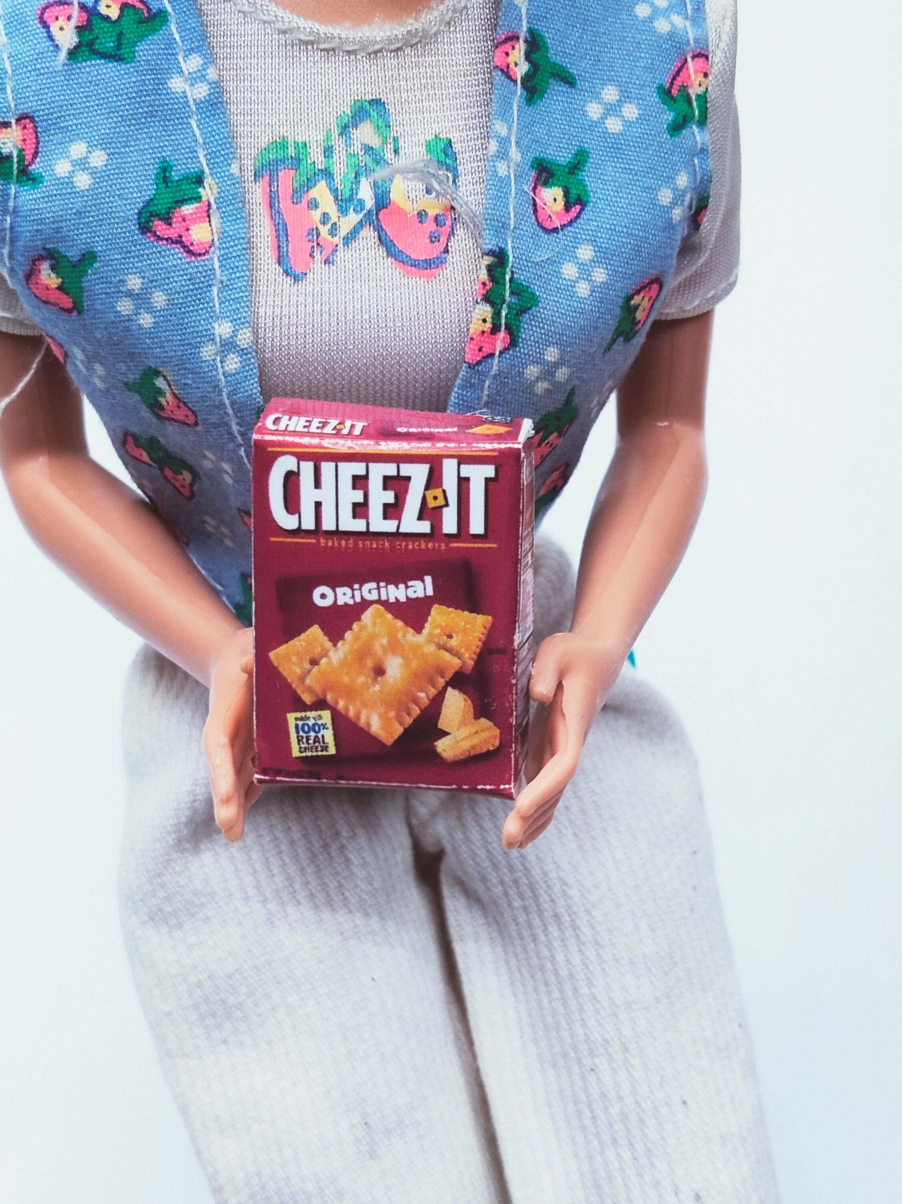

T-Shirts & Snacks
Pick up your shirt to make sure you stand out as a mentor!
Feel free to partake of the many snacks available!

Slide 26

Food & Beverages
Breakfast, Lunch, and Dinner will be served each full day of the Hackathon! Specifics TBD

Slide 27

THANK YOU!
Any questions?

